Slide 1
The Penguins of Callisto
We are do
Board game
Educate
spaaaaaaaceee

Slide 2







Space Event Deck
Engineering Cubes
Launch pad
Mission Control Cubes
Mission Cards
Emergency PR
Splash pad
Cubes
Research item deck
Media card deck
Space Event Discard
Research Cubes
Destination Space
Communication Cubes

Slide 3
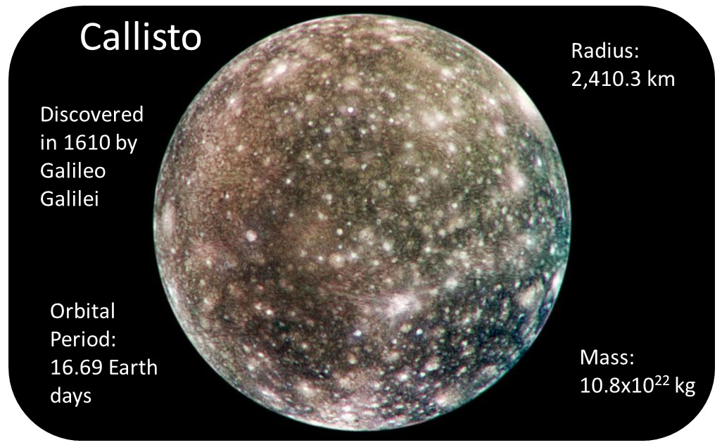
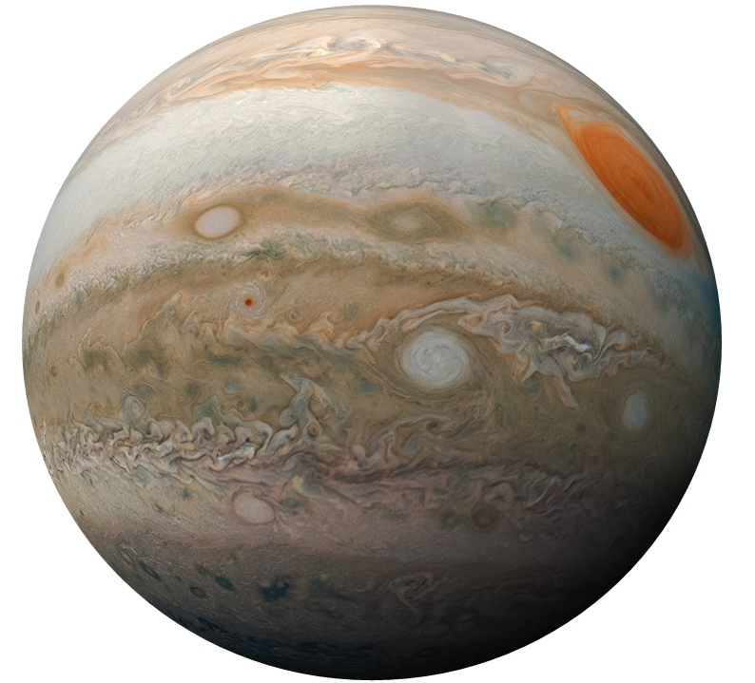
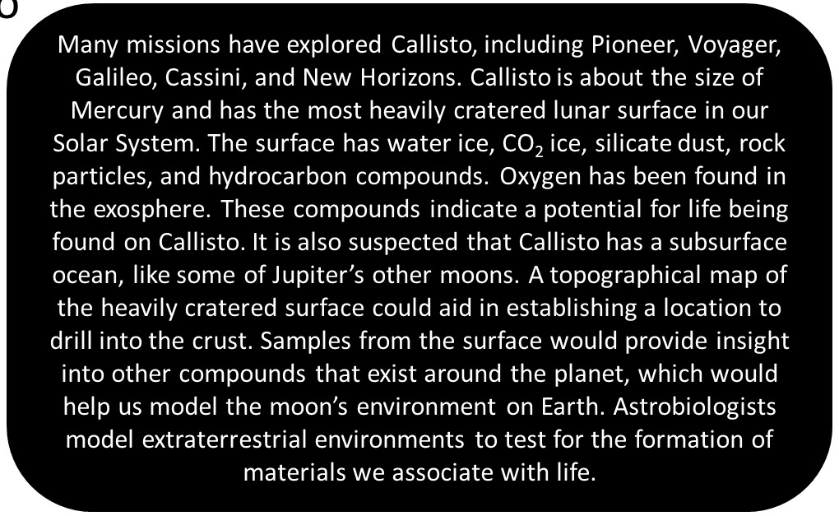
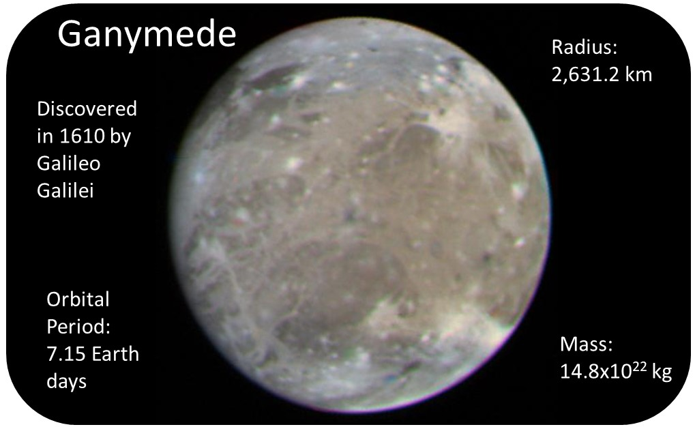
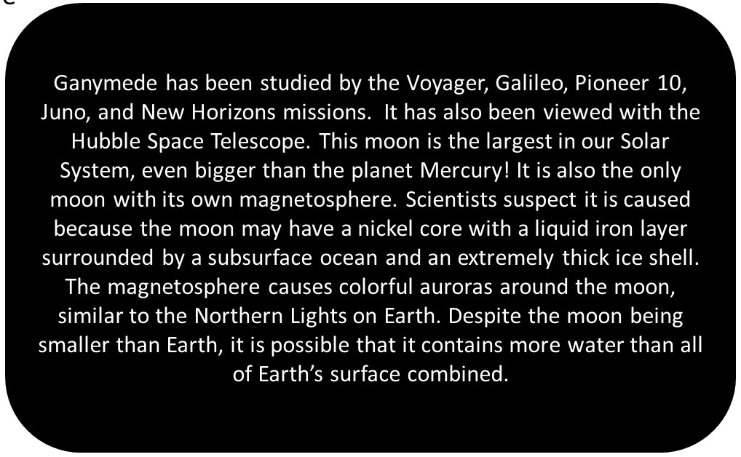
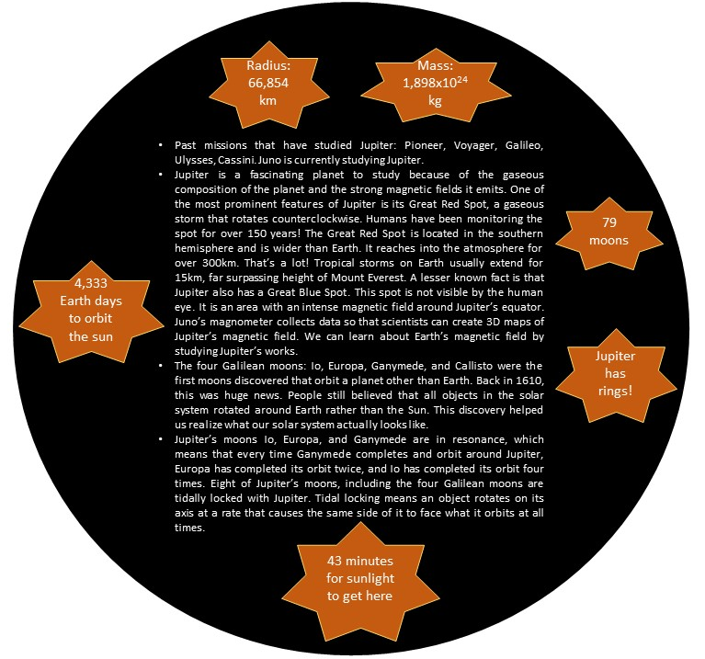
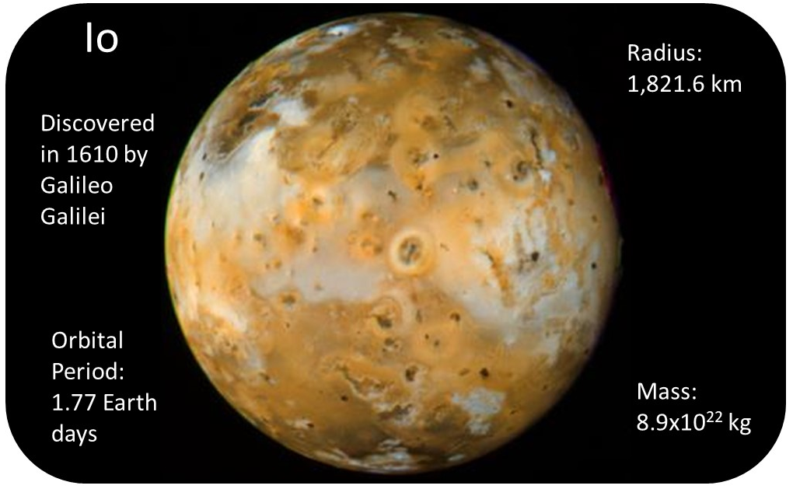
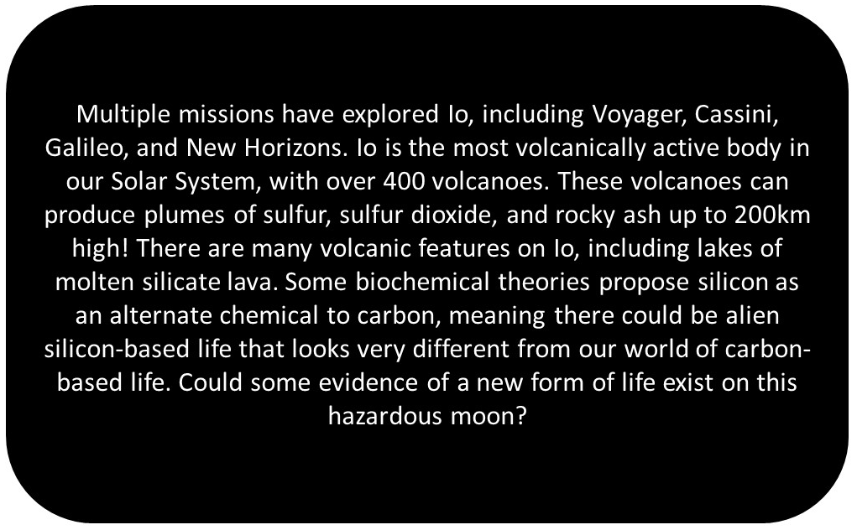
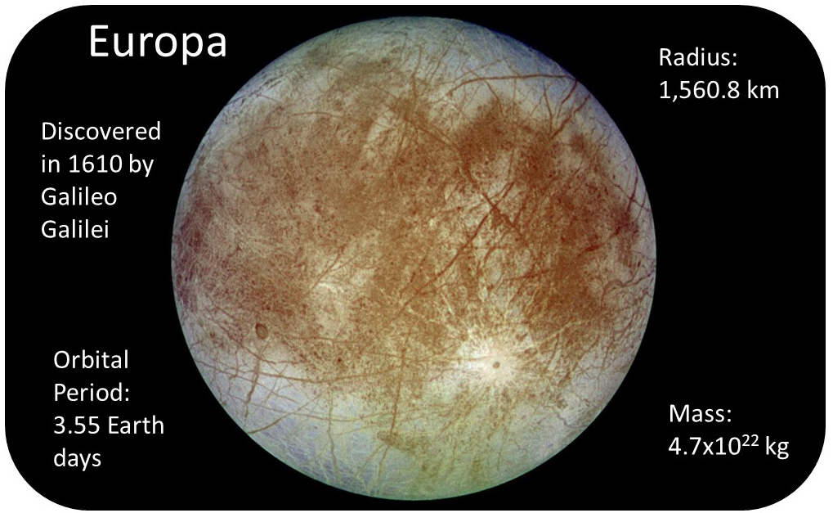
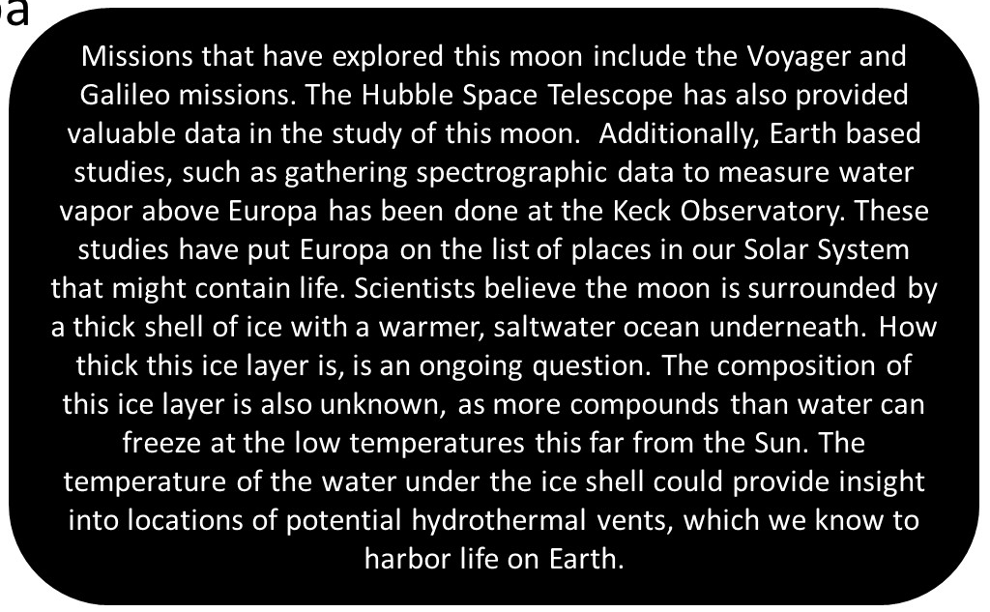

Slide 4
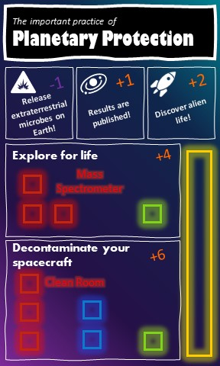
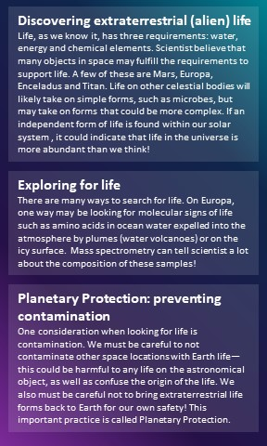
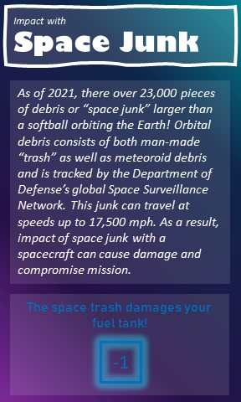


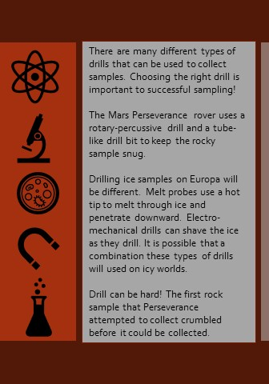
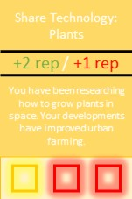
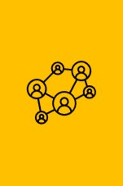
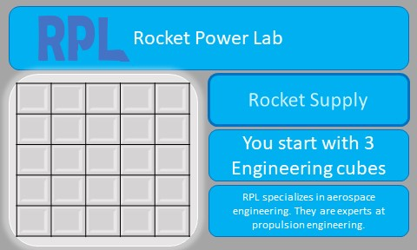

Slide 5
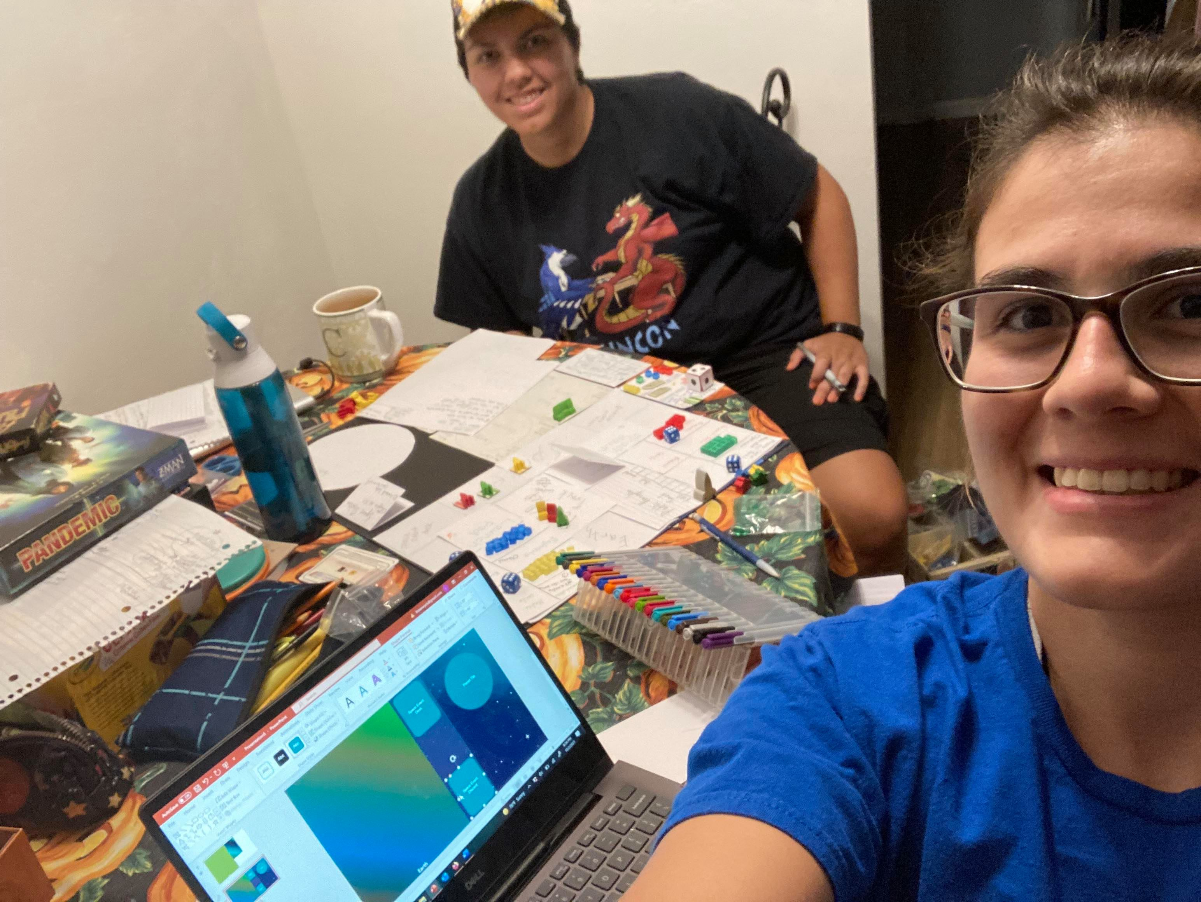
https://github.com/lkstanwyck/SpaceApps2021

Slide 6
Facts
70,000 unique attendees, a record-breaking 538 exhibiting companies, and an all-time-high 19,600 ticketed events
Board games teach teamwork, concentration, problem solving skills, improve motor skills, listening, the importance of failure-→all things valuable to space industry!
Our board game will also teach its players about the past and future space science!

Slide 7
Words
Hi! We’re Claudia and Lynn of the Penguins of Callisto. We chose to hack Space Quest: The Game. We’re both passionate about STEM education and we love board games. ________bg stats and stuff_______
Our game is called ________. The goal of the game is to increase public interest in space science by performing outreach and completing missions.

